Slide 1
The secret (silent) things belong to the Lord our God, but those things which are revealed (spoken) belong to us and to our children forever, that we may do all the words of this law.
Deuteronomy 29:29

Slide 3
1 Peter 4:11
“Where the Scriptures speak, we speak; where the Scriptures are silent, we are silent.”
Thomas Campbell (1808)
If anyone speaks, let him speak as the oracles of God.
The concept has long been respected and practiced—The Silence of God was viewed as prohibitive, not permissive.
Lord’s Supper: (Matt 26:26-28), Unleavened Bread & Fruit of the Vine.

Slide 5
“This is ultimately a discussion immersed in legalism, I believe. God gave us both his word and our brains.
I think he expects us to use both, and not necessarily to wind up with the same conclusions. Think and go, God will bless us.”
“Within Churches of Christ, the traditional understanding of silence is that it is prohibitive . . . We have conveniently ignored a number of examples that would complicate our simplistic approach…
I have no personal problems with trying to adhere, however inconsistently, to our ‘Law of Silence’ concept. But when we condemn other people to eternal damnation for not following it, I fear we are ‘teaching for doctrine the commandments of men.’”
“I’m back to think and go… If you look at some examples in the biblical narrative, then you’ll begin to see that ‘think and go’ is pretty much normative for God's people. God will bless us, I believe. He's surely blessed me, even though I don’t have specific word for most of what I do.”

Slide 6
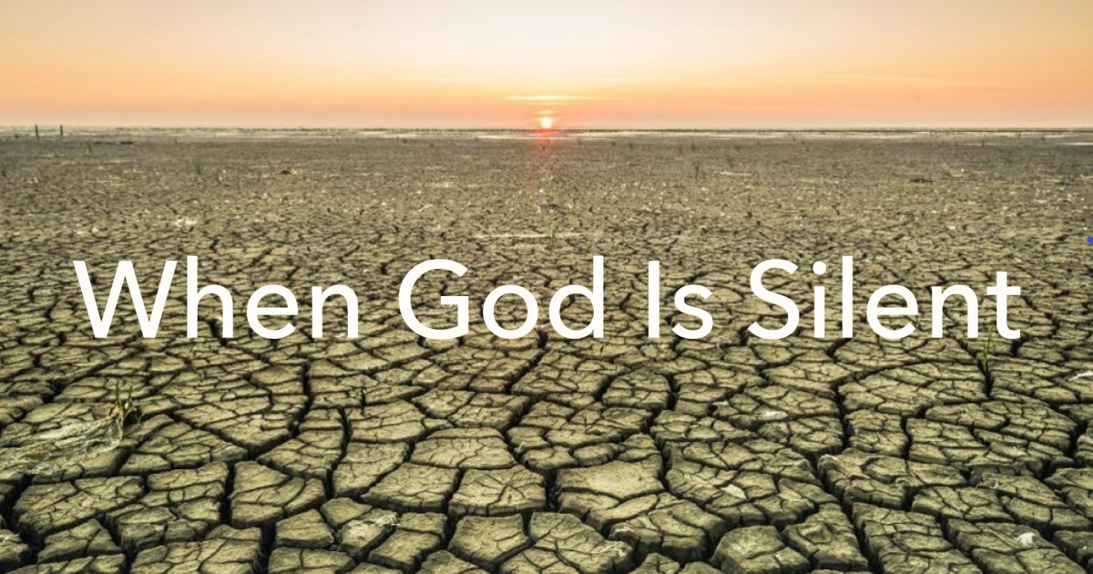
Silence: The absence of any sound or noise; stillness.
The state or fact of being silent; muteness.
The absence of information!
God Approves, Num 30:4.
God Disapproves, Num 20:8-12.
Could mean Nothing, Jn 8:6.
What does it Mean?
Possibly 1 of 3 Things

Slide 7
And truly Jesus did many other signs in the presence of His disciples, which are not written in this book; but these are written that you may believe that Jesus is the Christ, the Son of God, and that believing you may have life in His name, (John 20:30-31).
And there are also many other things that Jesus did, which if they were written one by one, I suppose that even the world itself could not contain the books that would be written, (John 21:25).

Slide 8
Are these some of the miracles Jesus did that are unrecorded?
We don’t know—the scriptures are SILENT about these!
1 Corinthians 2:10-13
Raise a rich young man from the dead?
Make birds from clay & give them life?
Heal a woodcutter’s injured foot?
Harvest 100 bushels of wheat from a single seed?
Lengthen a board that was too short to make it fit?
Heal James after a deadly viper bite?
else
What
did Jesus do?

Slide 9
“If this so-called ‘law of silence’ were to be followed ‘religiously,’ then our PA systems, PowerPoint usage, song books, and other things which we commonly use in worship would all be outlawed. It really is time to apply some common sense to this ‘law,’ and the way it is applied by so many…”
Hmm,
I Wonder…

Slide 10
Exodus 25:13-14
2 Samuel 6:3, 7
1 Chronicles 15:13

Slide 11
God
is not
SILENT
“Speaking to one another in psalms and hymns and spiritual songs, singing and making melody in your heart to the Lord” (Ephesians 5:19).
Question before us is:
Do we respect that which is revealed?

Slide 12
God
is not
SILENT
“Therefore we were buried with Him through baptism into death, that just as Christ was raised from the dead by the glory of the Father, even so we also should walk in newness of life.”
(Romans 6:4)
Question before us is:
Do we respect that which is revealed?

Slide 13
God
is not
SILENT
“Now concerning the collection for the saints, as I have given orders to the churches of Galatia, so you must do also: On the first day of the week …”
(1 Corinthians 16:1-2).
Question before us is:
Do we respect that which is revealed?

Slide 14
God
is not
SILENT
“Now on the first day of the week, when the disciples came together to break bread, Paul, ready to depart the next day, spoke to them and continued his message until midnight.”
(Acts 20:7).
Question before us is:
Do we respect that which is revealed?

Slide 15
2 Samuel 7:1-7
¹ Now it came to pass when the king was dwelling in his house, and the Lord had given him rest from all his enemies all around, ² that the king said to Nathan the prophet, see now, I dwell in a house of cedar, but the ark of God dwells inside tent curtains. ³ Then Nathan said to the king, go, do all that is in your heart, for the Lord is with you. ⁴ But it happened that night that the word of the Lord came to Nathan, saying, ⁵ go and tell My servant David, thus says the Lord: would you build a house for Me to dwell in? ⁶ For I have not dwelt in a house since the time that I brought the children of Israel up from Egypt, even to this day, but have moved about in a tent and in a tabernacle. ⁷ Wherever I have moved about with all the children of Israel, have I ever spoken a word to anyone from the tribes of Israel, whom I commanded to shepherd My people Israel, saying, why have you not built Me a house of cedar?
¹ Now it came to pass when the king was dwelling in his house, and the Lord had given him rest from all his enemies all around, ² that the king said to Nathan the prophet, see now, I dwell in a house of cedar, but the ark of God dwells inside tent curtains. ³ Then Nathan said to the king, go, do all that is in your heart, for the Lord is with you. ⁴ But it happened that night that the word of the Lord came to Nathan, saying, ⁵ go and tell My servant David, thus says the Lord: would you build a house for Me to dwell in? ⁶ For I have not dwelt in a house since the time that I brought the children of Israel up from Egypt, even to this day, but have moved about in a tent and in a tabernacle. ⁷ Wherever I have moved about with all the children of Israel, have I ever spoken a word to anyone from the tribes of Israel, whom I commanded to shepherd My people Israel, saying, why have you not built Me a house of cedar?

Slide 16
Acts 15:1, 6, 23-24
¹ Now the apostles and elders came together to consider this matter. And certain men came down from Judea and taught the brethren, unless you are circumcised according to the custom of Moses, you cannot be saved.
⁶ Now the apostles and elders came together to consider this matter.
²³ They wrote this letter by them: The apostles, the elders, and the brethren, to the brethren who are of the Gentiles in Antioch, Syria, and Cilicia: Greetings. ²⁴ Since we have heard that some who went out from us have troubled you with words, unsettling your souls, saying, you must be circumcised and keep the law—to whom we gave no such commandment—

Slide 17
Hebrews 7:11-14
¹¹ Therefore, if perfection were through the Levitical priesthood (for under it the people received the law), what further need was there that another priest should rise according to the order of Melchizedek, and not be called according to the order of Aaron? ¹² For the priesthood being changed, of necessity there is also a change of the law. ¹³ For He of whom these things are spoken belongs to another tribe, from which no man has officiated at the altar. ¹⁴ For it is evident that our Lord arose from Judah, of which tribe Moses spoke nothing concerning priesthood.
Behold, I Myself have taken your brethren the Levites from among the children of Israel; they are a gift to you, given by the Lord, to do the work of the tabernacle of meeting (Numbers 18:6).

Slide 18
Numbers 30:3-7
³ Or if a woman makes a vow to the Lord, and binds herself by some agreement while in her father’s house in her youth, ⁴ and her father hears her vow and the agreement by which she has bound herself, and her father holds his peace, then all her vows shall stand, and every agreement with which she has bound herself shall stand. ⁵ But if her father overrules her on the day that he hears, then none of her vows nor her agreements by which she has bound herself shall stand; and the Lord will release her, because her father overruled her. ⁶ If indeed she takes a husband, while bound by her vows or by a rash utterance from her lips by which she bound herself, ⁷ and her husband hears it, and makes no response to her on the day that he hears, then her vows shall stand, and her agreements by which she bound herself shall stand.
But God was NOT Silent

Slide 19
The revealed Word of God serves as our boundary (Rev 22:18-19; 2 Jn 9).
Acting on Silence = Acting on Ignorance (1 Cor 2:12).
Acting on Silence = Seeking Our Own Will (Matt 6:10).
Acting on Silence = Legalism (establishing our own righteousness, Rom 10:3).
Now these things, brethren, I have figuratively transferred to myself and Apollos for your sakes, that you may learn in us not to think beyond what is written, that none of you may be puffed up on behalf of one against the other.
1 Corinthians 4:6

