Slide 1
Bob Dylan
1964
Come mothers and fathers-throughout the land And don't criticize-what you can't understand Your sons and your daughters-are beyond your command Your old road is rapidly agin’ –please get out of the new one If you can't lend your hand-for the times they are a-changin'

Slide 3
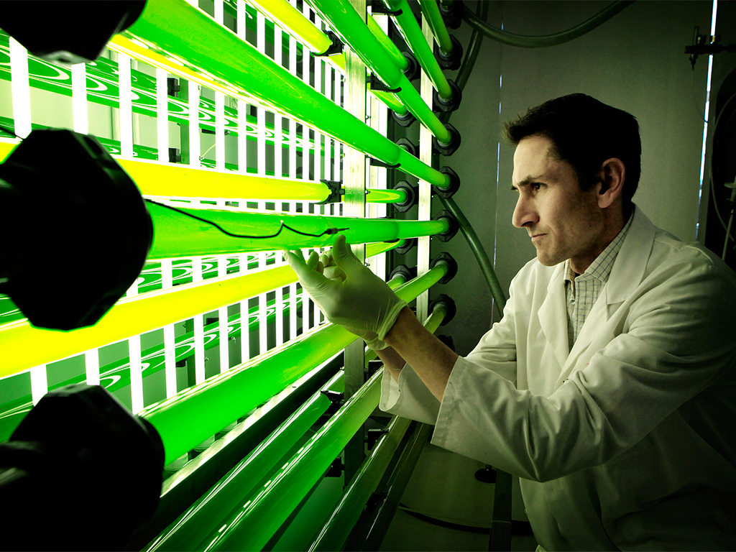
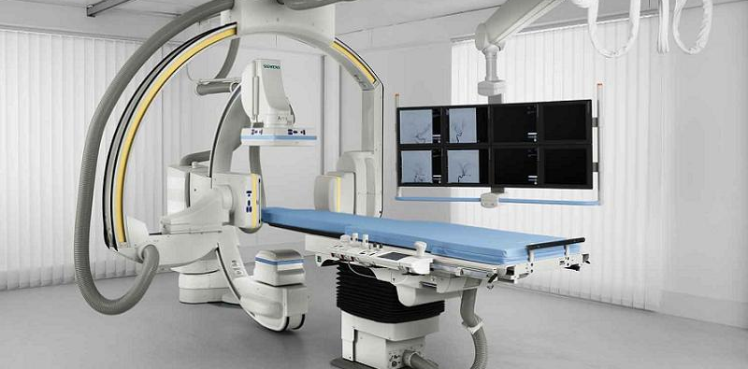

Slide 4
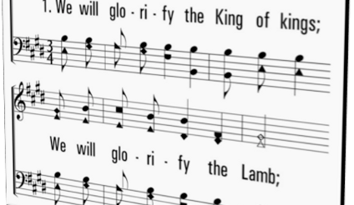

Slide 5
Therefore, brethren, stand fast and hold the traditions which you were taught, whether by word or our epistle.
2 Thessalonians 2:15
Thus says the Lord: Stand in the ways and see, and ask for the old paths, where the good way is, and walk in it…
Jeremiah 6:16
Therefore, my beloved brethren, be steadfast, immovable, always abounding in the work of the Lord, knowing that your labor is not in vain in the Lord.
1 Corinthians 15:58

Slide 6
Many Advocate
W/O Change, the church will not be appealing to folks today,
W/O Change, the church will not be relevant in the 21st century,
Our worship doesn’t make sense to people, it’s too weird,
We need to become more “relational” & less doctrinal,
We’re too preoccupied with the past; we’re lost in the ‘50s,
This “black and white” mentality is a “turn-off” to young people,
There must be more dialogue and less condemnation!

Slide 7
No, no, no, no, no…
But ye are a chosen generation, a royal priesthood, an holy nation, a peculiar people…
1 Peter 2:9 (KJV)
But you are a chosen generation, a royal priesthood, a holy nation, His own special people…
1 Peter 2:9 (NKJV)
If we aren’t odd, strange, weird or peculiar then we are unsound.
If we use any printed class material, then we are in error.
If we use computers, PowerPoint, etc., then we are liberal.

Slide 8
How can we know what we can change and what we cannot change?
How might we determine the difference between change that is acceptable and change that is unacceptable?
How Can we Know?

Slide 9
But You are the same, and Your years will have no end…
Psalm 102:27
Before the mountains were brought forth, or ever You had formed the earth and the world, even from everlasting to everlasting, You are God.
Psalm 90:2
For I am the Lord, I do not change…
Malachi 3:6
Every good gift and every perfect gift is from above, and comes down from the Father of lights, with whom there is no variation or shadow of turning.
James 1:17

Slide 10
all under His dominion cannot change

Slide 11
You shall not add to the word which I command you, nor take from it, that you may keep the commandments of the Lord your God which I command you ~ Deuteronomy 4:2
But even if we, or an angel from heaven, preach any other gospel to you than what we have preached to you, let him be accursed ~ Galatians 1:8
For I testify to everyone who hears the words of the prophecy of this book: If anyone adds to these things, God will add to him the plagues that are written in this book; and if anyone takes away from the words of the book of this prophecy, God shall take away his part from the Book of Life, from the holy city, and from the things which are written in this book ~ Revelation 22:18-19

Slide 12
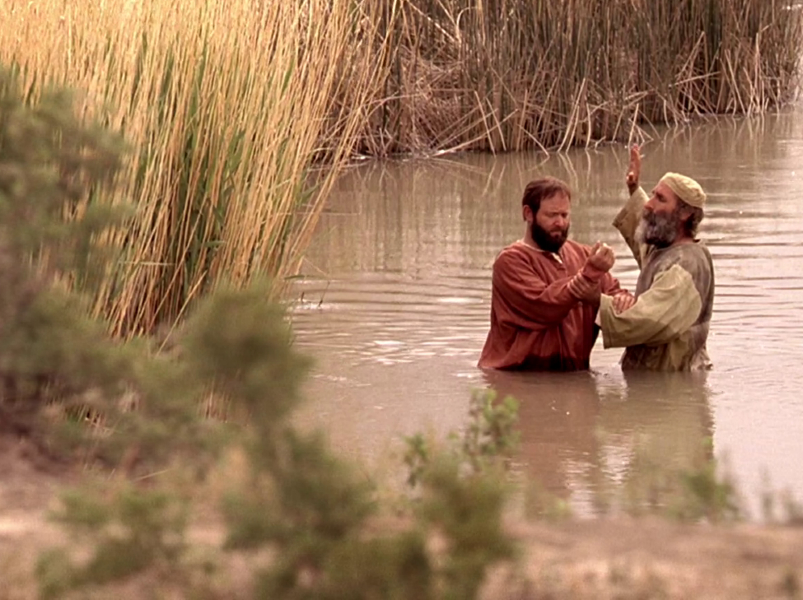
All Still Sin, Rom 3:10, 23
Wages the Same, Rom 6:23
Jesus is only Solution, Jn 14:6
Message the Same, Lk 24:47; Acts 2:14, 37
Hear: Rom 10:17
Believe: Jn 8:24
Repent: Acts 17:30
Confess: Acts 8:37
Baptized: Acts 22:16
Live Faithfully: Rev 2:10
Plan of Salvation
Under God’s Control
Cannot be Changed

Slide 13
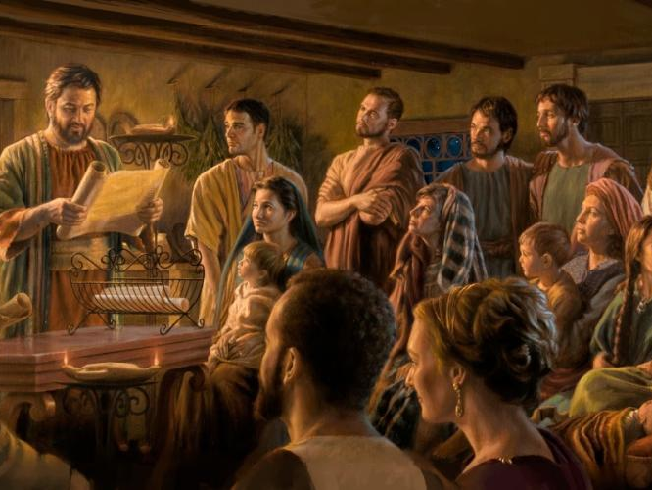
God Still Demands our Worship, Jn 4:24
Jesus Still Wonders Why, Lk 6:46
The church is Still to glorify God, Eph 3:21
1st Day of the Week, Lord’s Supper, Lk 22:19, Acts 20:7
Contribution, 1 Cor 16:1-2; 2 Cor 8:7; 9:7
Singing, Eph 5:19
Prayer, 1 Cor 14:15
Teaching / Preaching, Matt 15:9; 1 Cor 14:19
Collective Worship
Under God’s Control
Cannot be Changed

Slide 14
God Created only two Sexes (Genders), Gen 1:27; Matt 19:4
God NEVER spoke of multiple genders, Deut 31:12; Lev 20:27; 1 Cor 11:3-16
True Science (not fake science) confirms this.
Hormones, implants, surgeries does not change one’s sex.
Cross-Dressing is sinful, Deut 22:5
Male & Female
Under God’s Control
Cannot be Changed

Slide 15
God intended marriage to be for a man & woman, Gen 2:24; Matt 19:4-6
God joins together a man & woman—He never joins any same-sex couple, Rom 1:26-28; Lev 18:22
God created marriage to last a for lifetime, Matt 19:6, 19; Mal 2:16; Rom 7:2
God intends for children to be raised in a home with a mother (female) & father (male), Eph 6:1-2, Prov 1:8
The Institution of Marriage
Under God’s Control
Cannot be Changed

Slide 16
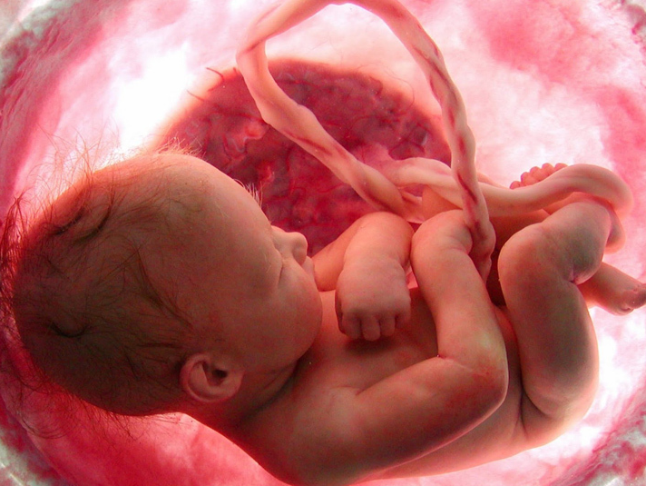
Abortion is Murder, Exod 21:22-25
The life in the womb is a creation of God, Psa 139:13-16
God is aware of the life within the womb, Isa 44:24
Jeremiah was a prophet of God before he was born, Jer 1:5
Paul was an apostle of Christ before he was born, Gal 1:15
All Life (born & unborn) is precious to God.
Preborn Life
Under God’s Control
Cannot be Changed

Slide 17
God is Light (w/o sin), 1 Jn 1:5
God, therefore, demands that we strive to live above sin, 1 Pet 1:14-17
We are not to conform to the standards of the world, Rom 12:1-2
We cannot blur God’s guidelines of good and evil with the world’s, Isa 5:20-21
Adultery, fornication, lying, drunkenness, hate, gossip, etc. are ALWAYS SINFUL
Morality
Under God’s Control
Cannot be Changed

Slide 18
We are members of a body whose Head never changes ~ Heb 13:8, “Jesus Christ is the same yesterday, today, and forever.”
We are children of a Father Who never changes ~ Jas 1:17, “…Father…with whom there is no variation or shadow of turning.”
We are Inhabitants of an immovable kingdom ~ Heb 12:28, “…we are receiving a kingdom which cannot be shaken…”
In the words of the hymn, “Build your hopes on things eternal, Hold to God’s unchanging hand."

